Slide 1

Exploratory Data Analysis of Product Failures
Phase 1: Summary of Findings

Slide 2
Dataset Overview
The dataset consists of various product-related attributes, including:
Product code (categorical)
Loading (numerical)
Multiple measurement variables
Failure as the target variable (Yes/No)
Phase 1 analysis focuses on identifying potential predictors of failure

Slide 3
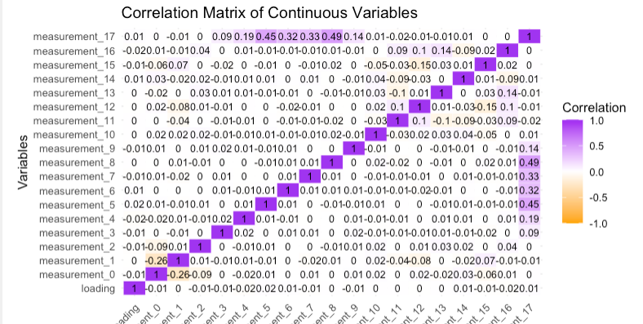
Correlation Matrix with Failure
The correlation matrix highlights that some numerical variables, particularly loading and certain measurements, have a relatively strong relationship with the "failure" variable
A positive correlation suggests that as these values increase, so does the likelihood of failure
This insight points towards loading as a potentially strong predictor, along with some of the measurement features.

Slide 4
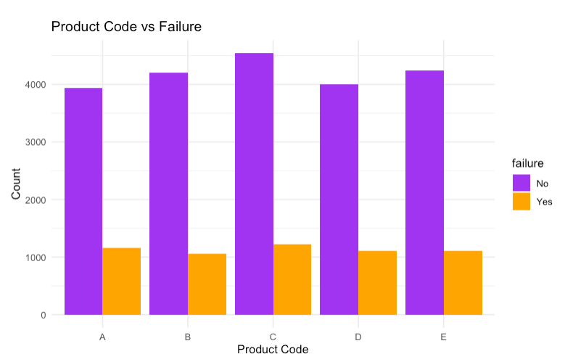
Failure Rate by Product Code
The distribution of failures across product codes reveals distinct patterns
For example, some product codes may have significantly higher failure rates compared to others
This suggests that the material composition or design associated with different product codes could contribute to product reliability
Understanding these differences can help in targeting specific products for improvement

Slide 5
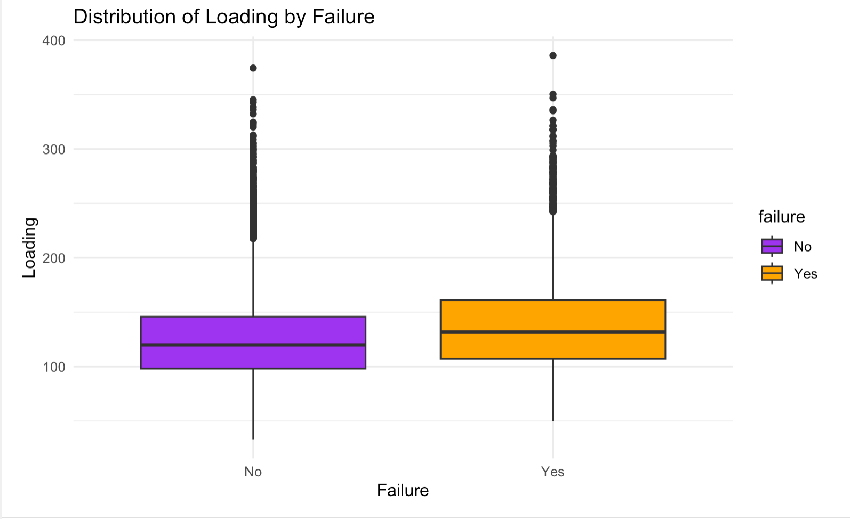
Distribution of Loading Variable
The boxplot shows that products with higher loading tend to fail more frequently
There is a visible increase in median loading for failed products, suggesting a threshold where loading could increase failure risk
This relationship indicates that monitoring and managing loading levels could be critical to reducing failure rates

Slide 6
Conclusion and Next Steps
Phase 1 Key Findings:
The 'loading' variable shows a strong relationship with failure
Product codes show distinct failure patterns, suggesting product type may impact failure rates
Certain measurement variables also correlate with failure, though not as strongly as loading
Phase 2 will involve building predictive models to confirm these findings and refine the analysis

